Slide 1


Slide 2
Introduction
Basic part:
We can use some categorical examinations (GCS and APACHE) for predicting Hospital_death, which means whether the patient will die in this hospitalization or not.
Advanced part:
We can use some numerical data (Age, BMI, and Glucose) for predicting Diabetes_mellitus, which means whether the patient has diabetes or not.

Slide 3
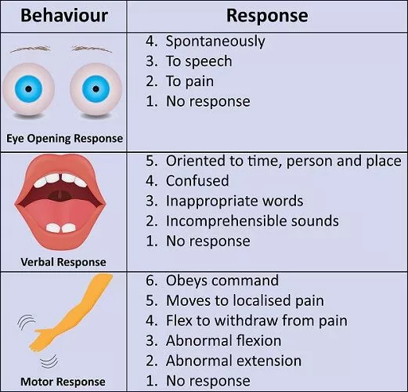
Dataset
Basic part: categorical data (i.e. the value is discrete)
Input: 9 features
GCS (Glasg. ow Coma Scale) is a medical indicator for assessing the level of a patient's consciousness.
gcs_eyes_apache: 1 (bad) ~ 4 (good)
gcs_verbal_apache: 1 (bad) ~ 5 (good)
gcs_motor_apache: 1 (bad) ~ 6 (good)
APACHE was designed to measure the severity of disease for adult patients admitted to ICU (intensive care units).
ventilated_apache(機械呼吸器): whether have ventilated or not (0/1)
albumin_apache(白蛋白)
bilirubin_apache(膽紅素)
bun_apache(blood urea nitrogen血液尿素) whether did each of the examinations or not (0: no/1: yes)
creatinine_apache(肌酸酐)
fio2_apache(吸入氧分壓)
Output: Hospital_death

Slide 4
Dataset
Advanced part: numerical data (i.e. the value is continuous)
Input: 3 features
Age, BMI, and Glucose_apache(血糖)
Output: Diabete_mellitus

Slide 5
Goal
Basic part:
Predict whether patient will die in this hospitalization or not.
Advanced part:
Predict whether patient has diabetes or not.

Slide 6
Grading Policy
Item | Score
Basic Implementation | 55%
Advanced Implementation | 40%
Report | 5%

Slide 7
Basic Implementation (55%)
Given the GCS and APACHE features of patient previously recorded in the hospital.
Implement the Naïve Bayesian Classifier to do the categorical classification
Please use the files we provide as your input
Save the table (3D dictionary) of Naïve Bayesian Classifier as pickle file
Save the prediction for the testing data

Slide 8
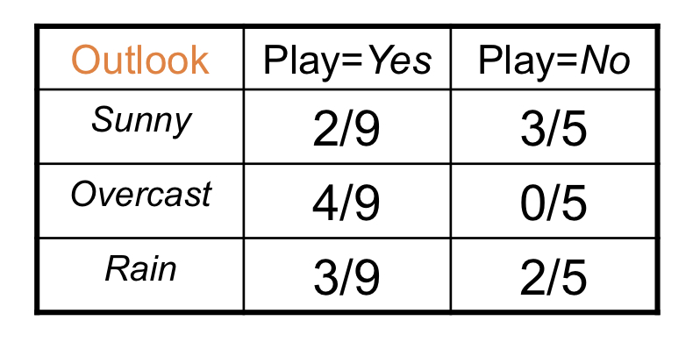
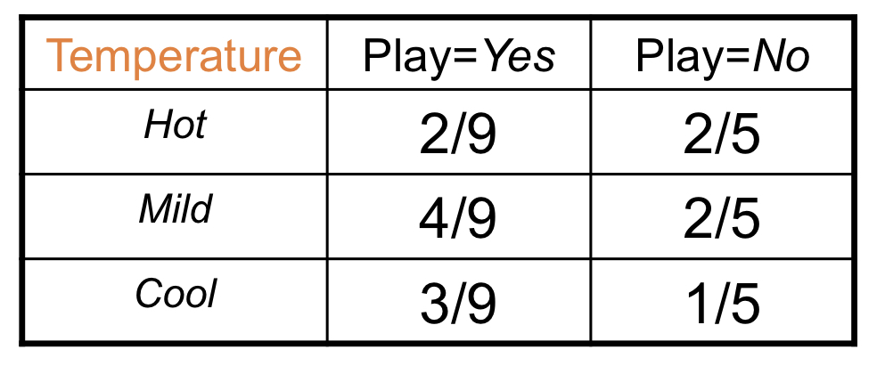
Basic Grading Policy
Naïve Bayesian Classifier table (3-D dict: feature_probs_table) – 25%
Structure: feature_probs_table[class][feature][value]
Example: feature_probs_table[0][‘gcs_eyes_apache’][3]
TA will check five values from the table, 5% for each
Testing f1-score – 30%
If your f1-score of the positive class is > 0.3 on testing set, you will receive 30%.
e.g. in L3-Bayesian Classifier p.15
feature
class
value
feature
class
value

Slide 9
Advanced Implementation (40%)
Given numerical data (Age, BMI, and Glucose_apache…) as features
You need to implement the Gaussian Naïve Bayesian Classifier.
Please use the files we provide as your input
Save the table (3D dictionary) of Gaussian Naïve Bayesian Classifier as pickle file
Try different methods to improve the performance
Save the prediction for the testing data

Slide 10
Advanced Grading Policy
Gaussian Naïve Bayesian Classifier table (3-D dict: feature_mean_var_table) – 20%
Structure: feature_mean_var_table[class][feature][params]
Example: feature_mean_var_table[0][‘bmi’][‘mean’]
Example: feature_mean_var_table[0][‘bmi’][‘var’]
TA will check ‘Age’ and ‘Glucose_apache’ mean and variance, 5% for each
Testing f1-score –5%
If your f1-score of the positive class > 0.35 on testing set, you will receive 5%
Ranking with others –15%
Those whose f1-score for the positive class is > 0.35 on testing set will be ranked to receive a different score

Slide 11
Possible ways to improve your performance
You can deal with the outliers.
You can try first converting real numbers into discrete values and then using Naïve Bayesian for classification.
You can try giving the prior a different weight for decision-making.
…(Anything you want to try based on Bayesian)

Slide 12
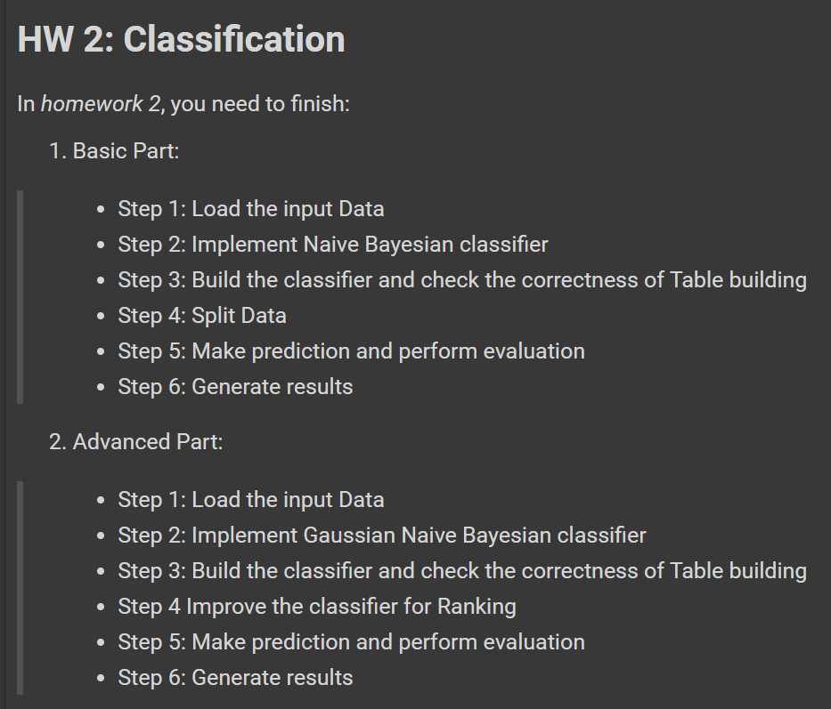
Template
You must use the given file “hw2_template.ipynb” to build the model
Except for the imported packages in the template, you cannot use any other packages for both basic and advanced part

Slide 13
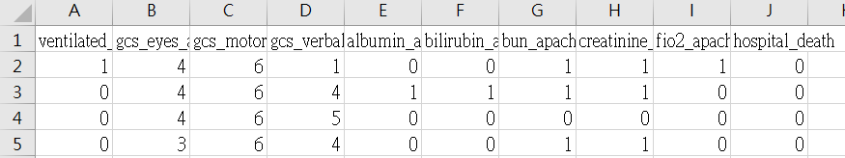
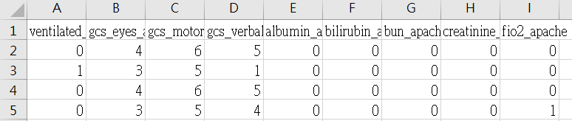
Basic Input File Format
There will be two input files:
“hw2_basic_training.csv”
First row is header of features with ground truth
There are 80000 rows records, one record for one patient
“hw2_basic_testing.csv”
First row is the header of features
There are 9812 rows records, you need to predict hospital_death as 0 (negative) or 1 (positive)
hw2_basic_training.csv
hw2_basic_testing.csv

Slide 14
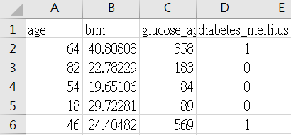
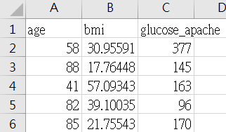
Advanced Input File Format
There will be two input files:
“hw2_advanced_training.csv”
First row is header of features with ground truth
There are 65,000 rows records, one record for one patient
“hw2_advanced_testing.csv”
First row is the header of features
There are 9,889 rows records, you need to predict diabetes_mellitus as 0 (negative) or 1 (positive)
hw2_advanced_training.csv
hw2_ advanced_testing.csv

Slide 15
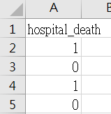
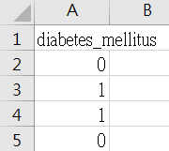
Prediction Output File Format
The prediction of both basic and advanced you turned in must follow this format
Basic Part
“hw2_basic_prediction.csv”
Advanced Part
“hw2_advanced_prediction.csv”
Basic part: each row represents “hospital_death” with the header
Advanced part: each row represents “diabetes_mellitus” with the header
Please make sure your model can correctly output this format of csv file
hw2_basic_prediction.csv
(the values are examples)
hw2_advacned_prediction.csv
(the values are examples)

Slide 16
Pickle File For Table
When call the build_table method of the classifier for both basic and advanced, you will get a table for the prediction, we want to check the correctness of your tables:
Note: Please just follow the execution order of template (YOU NEED TO BUILD THE TABLE **BEFORE, BEFORE, BEFORE** YOU DO TRAIN_VAL_SPLIT OR ANY PRE-PROCESSING), then you will be able to output the tables correctly.
Basic Part
Output feature_probs_table as “hw2_basic_table”
Advanced Part
Output feature_mean_var_table as “hw2_advanced_table”

Slide 17
Report
Named as “hw2_report.pdf”
Briefly describe why we take log when implement the Bayesian classifier? (1%)
Briefly describe the difference between Naïve Bayesian and Gaussian Naïve Bayesian classifier? (1%)
Briefly describe the difficulty you encountered (1%)
Summarize how you solve the difficulty and your reflections (2%)
No more than one page

Slide 18
Assignment 2 Requirement
Do it individually! Not as a team! (The team is for the final project)
Announce date: 2023/10/17
Deadline: 2023/10/31 23:59 (Late submission is not allowed!)
Hand in your files in the following format (Do not compress them!)
hw2_basic_prediction.csv
hw2_basic_table
hw2_advanced_prediction.csv
hw2_advanced_table
hw2.ipynb
hw2_report.pdf

Slide 19
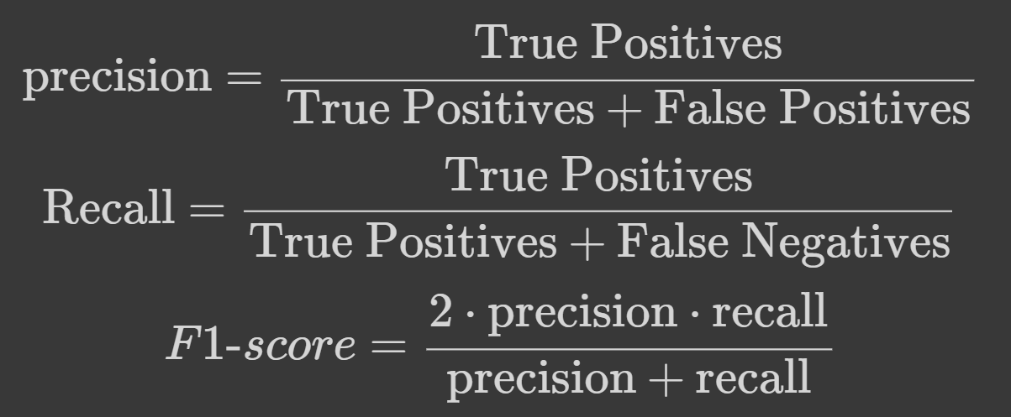
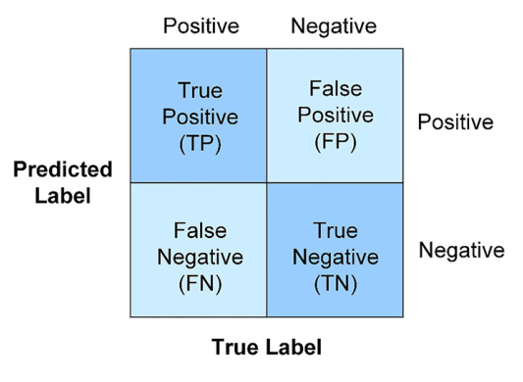

The Evaluation Metric
F1-score:
For example:
The value you predicted:
$\hat{y}=[0, 0, 0, 1, 1, 1, 0]$
Ground Truth:
$y=[0, 0, 0, 1, 0, 0, 1]$
Precision = 1/(1+2) = 1/3
Recall = 1/(1+1) = 1/2
F1-score
= 2*(1/3)*(1/2) / (1/3+1/2)
= 2/5 = 0.4
1
2
1
3

Slide 20
Penalty
0 points if any of the following conditions happened
Plagiarism
Late submission
Not using a template or importing any other packages
Incorrect prediction format
Incorrect submission format

Slide 21
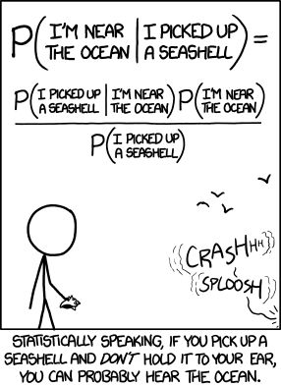
Questions?
Please make good use of discussion board on the eeclass
TA: Timothy Chang (timothy@gapp.nthu.edu.tw)
Do not ask for debugging.
Good luck and have fun!

